Slide 1
1) Schooling and Gradients 2) Long-Run Impacts of Early-Life Nutrition
Jere R. Behrman
William R. Kenan, Jr. Professor of Economics and Sociology
University of Pennsylvania
First Workshop of the
Health Inequality Network (HINet)
15 September 2011

Slide 2
1) Schooling and Gradients
Schooling thought to have important impacts on gradients.
Two simple empirical exercises to assess some dimensions of schooling impacts:
How much would more schooling targeted to poor reduce income inequality and poverty?
Do associations of schooling with health persist with within-MZ twin control for endowments?

Slide 3
1. How much would more schooling targeted to poor reduce income inequality and poverty?
Income distribution of interest in itself.
Also one channel through which schooling may affect health.
Simulations for Chile, country with high inequality
Behrman, Jere R.,“How Much Might Human Capital Policies Affect Earnings Inequalities and Poverty?” Estudios de Economia 38:1 (June 2011), 9-42.

Slide 4
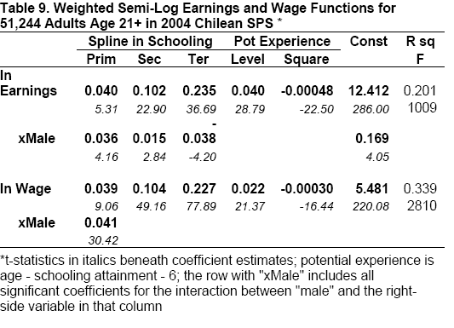
Semilog earnings & wage rate functions based on the 2004 SPS

Slide 5
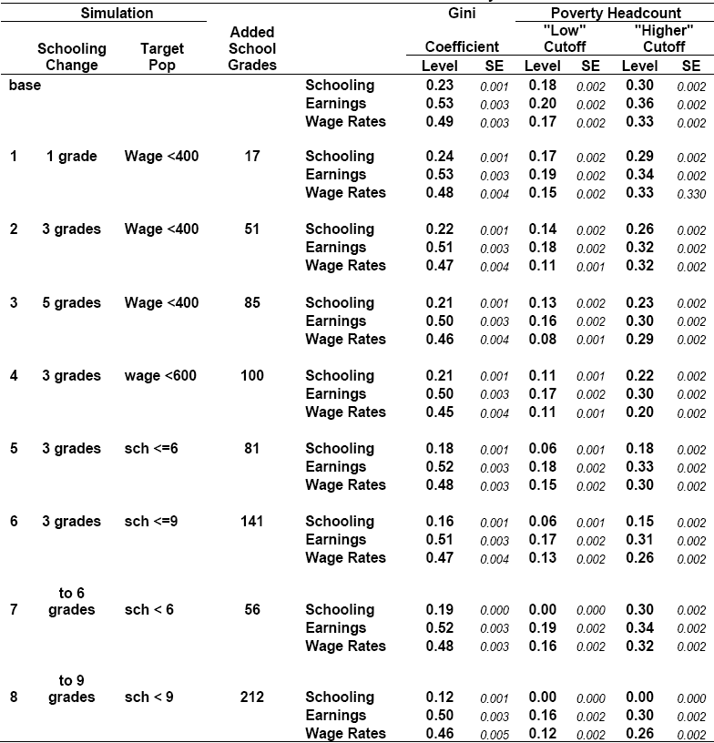

Slide 6
2. Do associations of schooling with health persist with within-MZ twin control for endowments?
Denmark, relatively equal income distribution and health system access.
Behrman, Jere R., Hans-Peter Kohler, Vibeke Myrup Jensen, Dorthe Pedersen, Inge Petersen, Paul Bingley and Kaare Christensen, 2011, “Does More Schooling Reduce Hospitalization and Delay Mortality? New Evidence Based on Danish Twins,” Demography (DOI) 10.1007/s13524-011-0052-1.

Slide 9
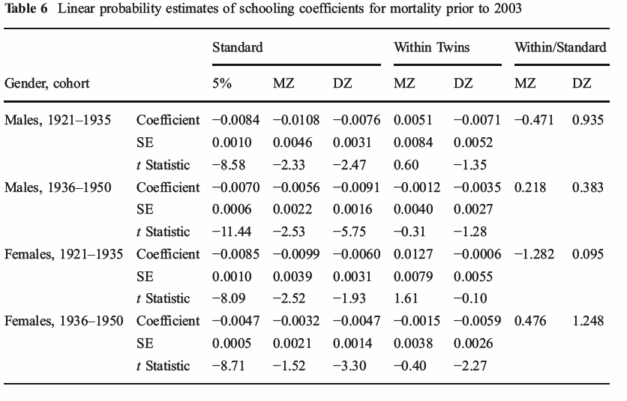

Slide 10
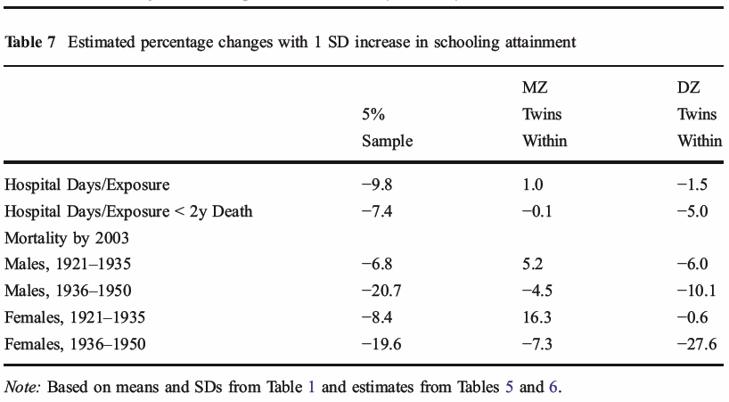

Slide 11
2) Long-Run Impacts of Early-Life Nutrition
1) Low Birth Weight
Behrman, Jere R. and Mark R. Rosenzweig, 2004, “Returns to Birthweight,” Review of Economics and Statistics 86:2 (May), 586-601.
Comparison of effects controlling for “endowments”
Twin fixed effects do not necessarily mean reduction in coefficients

Slide 13
2) Long-Run Impacts of Early Life Nutritional Supplementation in Malnourished Population
Community randomized supplementation trial (1969-1977) in 2 more populous and 2 less populous villages in El Progreso, Guatemala
Two villages (1 large, 1 small) received atole, a high protein-energy supplement; the other two (1 large, 1 small) received fresco, a less nutritive drink
Supplements were available to all twice daily throughout study at central locations in each village
Original study enrolled all children under age of 7 y in 1969 as well as newborns in1969-1977 (children were followed until 7 y of age or study end)

Slide 14
Formulae and nutrient content of the supplements per cup (180 ml)
 | Atole | Fresco
Ingredients (g/180 ml)
Incaparina | 13.5 | -
Dry skim milk | 21.6 | -
Sugar | 9.0 | 13.3
Flavoring agent | - | 2.1
Nutrients
Energy (kcal/180 ml) | 163 | 59
Protein (g/180 ml) | 11.5 | -
Both supplements contained vitamins and minerals equally per unit volume.
Notes:
14

Slide 15
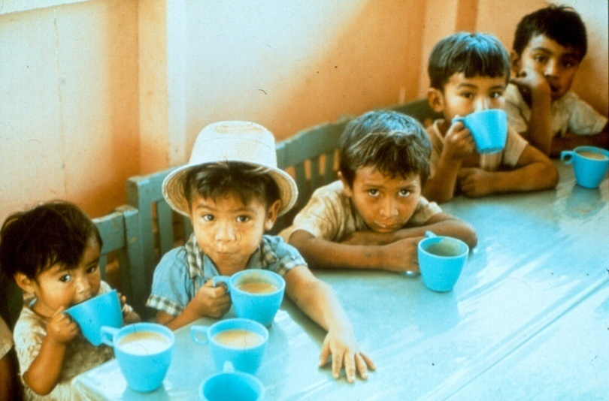
Supplement delivery

Slide 16
Key Subsequent Data Rounds
1988 Follow-up Study(FUS): Target population individuals in 1969-77 data collection, who were 11 to 26 y of age in 1988, in original villages and migrants to Guatemala City and to provincial capital.
2002-4 Human Capital Study (HCS): Target population individuals in 1969-77 data collection, who were 25-42 y of age, known or thought to be alive in Guatemala.
2006-7 Intergenerational Transfers Study (IGT): Target population individuals in 1969-77 data collection and HCS, who were 29-45 y of age, in or near original villages or Guatemala City with surviving parents.
Proportions lost to follow-up similar between individuals from the atole and fresco villages
Notes:
16

Slide 17
Height-for-age z score* for children 0-5y in 2006-7 by maternal exposure to supplementation
* WHO new standards
Kernel-weighted local polynomial smooth
Notes:
17
This population showed evidence of linear growth retardation, with a mean height-for-age z-score of -1.24, and 22% of the children stunted.
The standards describe normal child growth from birth to 5 years under optimal environmental conditions and can be applied to all children everywhere, regardless of ethnicity, socioeconomic status and type of feeding.
new standards that show how children should grow in all countries rather than merely describing how they grew at a particular time and place.
The study involved the recruitment of children who met a number of health criteria in 6 countries representing different regions of the world: Brazil, Ghana, India, Norway, Oman, and the United States. The 8,440 children included in the study were raised in environments that minimized constraints to growth such as poor diets and infection. In addition, their mothers followed health practices such as breastfeeding their children and not smoking during and after pregnancy.

Slide 18
Impact on education of exposure to improved nutrition from 0–3 y of age*
Schooling attainment: Effects found for women only
Improved by 1.2 grades (0.36 SD)
Reading: For men and women (25-42y), improved Inter-American Reading scores by 0.28 SD
Cognition: For men and women (25-42y), improved Raven’s Progressive Matrices scores by 0.24 SD
*Maluccio J, Hoddinott J, Behrman JR, Martorell R, Quisumbing A, and Stein A. 2009 “The impact of improving nutrition during early childhood on education among Guatemalan adults ,” Economic Journal 119 (April), 734–763.

Slide 19
Improved nutrition in early childhood and adult economic activity*
Exposure to improved nutrition before, but not after 3 years, improved wage rates (income/hour) for men but not women.
Exposure from 0–2 years had the greatest impact
Annual hours worked reduced by 222 (CI: -572 to 128)
Annual incomes were increased by $870 (CI: -$216, $1955)
Wages were increased by US $ 0.67 (CI: 0.16,1.17) or 0.45 SD
*Hoddinott J, Maluccio JA, Behrman JR, Flores R, and Martorell R. Effect of a nutrition intervention during early childhood on economic productivity in Guatemalan adults. Lancet 2008; 371:411-16.

Slide 20
Exposure to improved nutrition in early childhood and income (in US$) earned per hour; n=602 men; age 25-42 y*
P = 0.009
P = 0.007
US$/hr
P = 0.406
Window of exposure (months)
*Hoddinott J, Maluccio JA, Behrman JR, Flores R, and Martorell R. Effect of a nutrition intervention during early childhood on economic productivity in Guatemalan adults. Lancet 2008; 371:411-16.

Slide 21
Exposure to early childhood nutritional supplements & intergenerational effects*
Exposure for females, but not for males, affected their children 0-12 y. Significant increases in:
Birth weight of 116 g (CI: 17 g to 215 g)
Height 1.3 cm (CI 0.4 cm to 2.2 cm)
Head circumference 0.63 cm (CI 0.37 cm to 0.89 cm)
But NOT in weight, BMI, arm circumference, triceps and subscapular skinfold thicknesses
(Estimates robust to alternative treatments of standard errors and attrition.)
*Behrman JR, Calderon MC, Preston S, Hoddinott J, Martorell R and Stein A. 2009. “Nutritional Supplementation of Girls Influences the Growth of their Children: Prospective Study in Guatemala,” American Journal of Clinical Nutrition .

Slide 22
Boys versus girls
Notes:
22

Slide 23
Reduced-form estimates of impact of better supplementation in early life
% of children < 3 y with severe stunting (< -3 Z):
%
Martorell R. Overview of long-term nutrition intervention studies carried out in Guatemala (1968-1989). Food and Nutrition Bulletin 14(3):270-277, 1992.
Notes:
Add citations

