Slide 1


A conceptual basis for life course biology
Sir Peter Gluckman FRS
Chicago 2011
Chief Science Advisor to the Prime Minister of New Zealand

Slide 2
Some core issues
Life course studies have tended to be very siloed
  Biological
  Clinical
  anthropological
  educational
  sociological
  Economic
Humans are animals that live in a (changing) ecological context where change is driven by the technological capacity of our species, yet the speed of biological change is limited
When studying multiple aspects of the human condition evolutionary biology provides the one integrating principle on which to integrate biology, behaviour, physical and social environments and take into account the dimension of development

Slide 3
Some background concepts
Fundamental principles of
evolutionary medicine (1)
Our history, as a species, through our particular lineage and through our development, influences our susceptibility to disease.
Selection operates to maximise fitness
Selection does not operate to maximise health or longevity.
Fitness is particularly affected by life history traits (eg age of maturation)
Average human longevity has increased due to techno-cultural factors

Slide 4
Some background concepts
Fundamental principles of
evolutionary medicine (2)
Humans now live in very different ways and in different environments to those where the majority of selective processes affecting the modern human phenotype operated.
The constraints on evolutionary processes (the speed, substrate or direction of selection, or the scope of plasticity) in the presence of environmental novelty, often of human origin, can lead to ill health.
Definitions of normality, abnormality and disease are not absolute and are influenced by the environmental context of the individual and the individual variation in phenotype.

Slide 5
Do 70% of the world have a disease?
Context specific definition of normality
Until 10,000 years ago no human lived on cows milk (in Australia only 250 years ago)
The C→T mutation appeared 13.4 kb 5’ to the start site of the lactase gene in Europeans about 8000 years ago which matches the archaeological evidence for the date of adoption of dairy farming in Europe
If a person from a non-milk rearing ancestry stays away from milk then they are symptom free
If however they consume large amounts of milks they feel unwell – they do not have a disease - they are mismatched to their (nutritional) environment
So should we talk about people from the developing world as having lactase deficiency (ie a disease) or should we see them as the “normal” and we as the “abnormal”?
Adapted and maladapted depend on the circumstance – not on normal or abnormal physiology

Slide 6
Variable vulnerability
We all now live in obesogenic environments; the level of change in the environment possible will not take many people (at least in Asia) below the point of metabolic compromise
There is considerable individual and population variation in sensitivity : why?
Indian
UK

Slide 7
Variable responses to an obesogenic environment
  Evolutionary reasons – body weight is defended, time preferences are short for those at risk
  Differential sensitivity – genetic
  Differential sensitivity – developmental
    epigenetic/programming
    hard wiring of appetite control, resting energy expenditure, willingness to exercise
    set points for body weight control
  Cultural and societal factors influencing behaviour

Slide 8
DOHAD – difficulties in overcoming conventional wisdom
Three major issues have delayed acceptance of the DOHAD model
  The focus on birth weight
  The need for a biologically plausible mechanism
  Demonstrating the importance of the process
  All these issues have been addressed
    It is not about birth weight
    It involves epigenetics
    Development is critical

Slide 9
Responses of the developing organism to environmental cues
Disruptive to the developmental programme (teratogensis)
Adjust the developmental programme (developmental plasticity)
  Potentially adaptive (ie promote fitness) – but can have maladaptive consequences
  Responses to cues such as altered nutrition

Slide 10
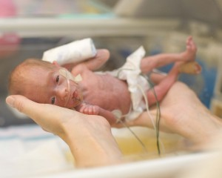
Trade-off with immediate benefit:
  early adaptive advantage with potentially longer term consequences

Slide 11
Changed developmental strategy with delayed but no obvious immediate benefit
  Altered developmental trajectory for potential fitness benefit in later life
  Very common phenomenon across taxa
  Underpinned by epigenetic processes
The fitness cost of error in prediction is not symmetrical
  To predict a high nutrition environment and end up in a low nutrition environment will have a greater fitness cost than predicting a low nutrition environment and ending up in a high prediction environment
  Hence humans have evolved with bias in prediction which is reinforced by the phenomenon of maternal constraint

Slide 12

Anticipation vs. bet-hedging
Bet-hedging is a phylogentically old adaptive response to variable environments for organisms which have high reproductive outputs
Bet-hedging organisms produce multiple offspring with a range of fixed phenotypes, some of which will be well adapted to the future environment
An asymmetric fitness environment (where the cost of being mismatched varies between environments) favours anticipation (PARs) rather than bet hedging
Anticipation need not be accurate to be the selected mechanism
Anticipation is the only possible strategy in monotocous slow producers where each pregnancy represents a high proportion of lifetime reproductive effort

Slide 13
Developmental pathways to obesity and metabolic disease
There are three major classes of developmental pathway to an increased risk of adiposity.
These pathways can coexist especially in developing world
  The mismatch pathway: primed by a less than optimal early life environment
  Pathways arising from maternal or infant nutrient excess
    Maternal obesity, early formula feeding
  Pathways arising from fetal hyperinsulinemia
    Gestational diabetes

Slide 14
The impact of parity
Parity p=0.004
Mother’s BMI in early pregnancy p<0.001
% body
fat at
28-31 years
Primiparous
Multiparous
Mother’s body mass index in early pregnancy (kg/m² )
Adjusted for age, sex &
current smoking
JCEM 2011

Slide 15
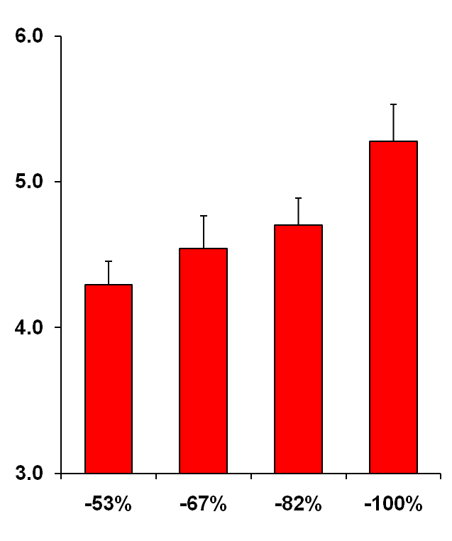
Epigenetic state at birth predicts body composition in childhood
PAH study children
aged 9 years
SWS children
aged 6 years
Child’s
fat mass
(kg)
r=0.32, P=0.009
n=64
r=0.47, P=0.014
n=27
r=0.20, P=0.002
n=239
Umbilical cord RXRA
Methylation CpG 2/13
Godfrey at al 2011
Values are means + SEM
Notes:
15

Slide 16
Low maternal carbohydrate intake in early pregnancy associated with higher RXRA gene promoter methylation
r=-0.26, P=0.027,
n=64
Umbilical
cord
RXRA:
methylation
CpG 2/13
N.B. No association with mother’s BMI or offspring birthweight
Maternal carbohydrate intake
in early pregnancy (quartiles)
Godfrey at al 2011

Slide 17
100
Smaller at birth, larger at 8yr
Smaller at birth
Larger at 8yr
80
Larger at birth
Larger at 8yr
60
% WHO REACHED MENARCHE
Smaller at birth
Smaller at 8yr
40
Larger at birth
Smaller at 8yr
20
0
9
10
11
12
13
14
15
AGE (YEARS)

Slide 18
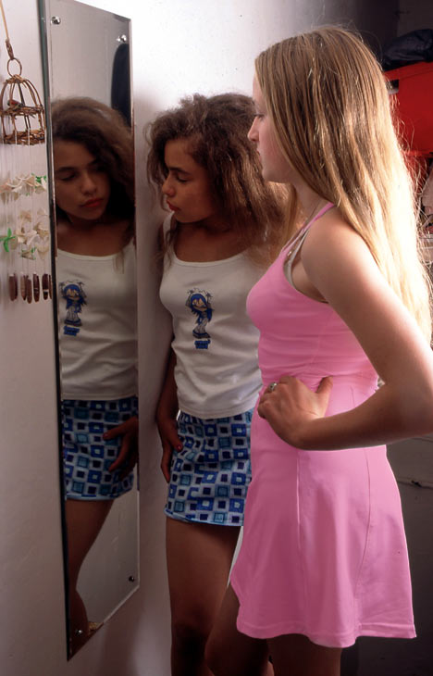
Post-pubertal adolescence is an evolutionary novelty
Puberty is the process of
biological maturation
Adolescence is the process of
attaining social recognition as
an adult
Prolonged post-pubertal
adolescence is a novel phase
of life

Slide 19
Menarche in the European female
20
“Mismatch”
Menarche
?
Age (years)
?
10
Psychosocial
maturation
Social
complexity,
Nutritional
overload
Agriculture
Settlement
Indust revol,
Social
improvement
20,000 ya
2,000 ya
200 ya
Present
Gluckman & Hanson (2006) Trends Endocrinol Metab

Slide 20
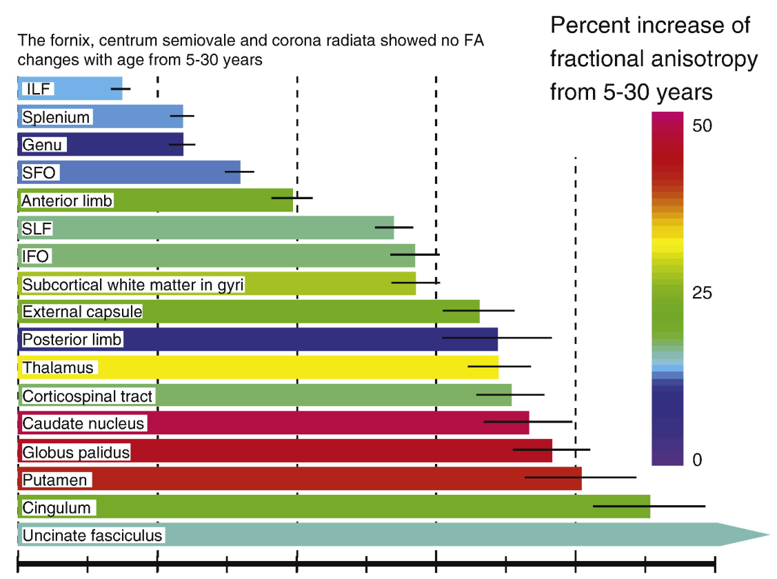
White matter and axonal organisation
Brain regions
Frontothalamic
pathways
5
10
15
20
25
30
Age at which brain region is
90% developed (years)
Lebel et al. (2008) NeuroImage

Slide 21
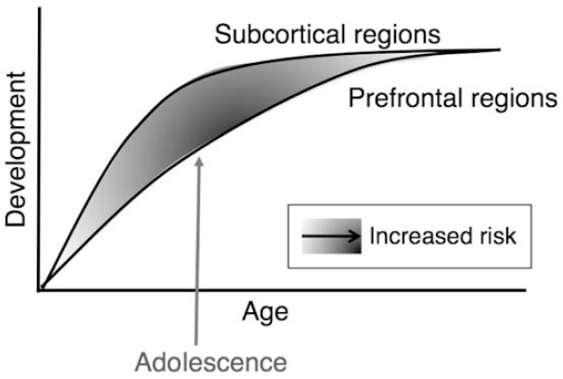
What are the consequences of a longer adolescence?
Somerville et al. 2010 Brain Cognition
Subcortical regions modulating emotions mature earlier than prefrontal regions mediating cognitive/impulse control
Imbalance is thought to account for the biased emotional and incentive-based behaviour of adolescence

Slide 22
Possible explanations
Brain maturation has always taken that long – but advanced skills not relevant in a simpler society – an exposed mismatch
Takes longer to learn
Cultural practices have slowed brain maturation

Slide 23
Males – early versus average
Bad health 1.9 times higher
Functional symptoms 2.2 times higher
Victimisation 1.7 times higher
Sexually active 1. 8 times higher
Smoking 1.8 times higher
Drunk in last 6 months 1.4 times higher
Cannabis 1.8 times higher
Illegal drugs 2 times higher
Depression 2.1 times higher
Suicide attempts 4.9 (3.0-8.1) times higher
All p<0.001
SMASH study: Michaud et al 2001

Slide 24
Contingent developmental cues
Critical window effects mean that cues may have different implications at different stages in development
  Nutrition and longevity
  Nutrition and puberty
  Stress and puberty
Because the phenotype is dependent on past experience, past experience may change the magnitude, direction of effect and significance of a later environmental exposure
  acting through epigenetic mechanisms, directly or indirectly

Slide 25
Epigenetic effects on phenotype
Within the life course
  Particularly induced in early life
  Often induced by maternal state (parental effects)
    direct induction
    recreation of inducing niche
Across generations
  Trans-meiotic epigenetic inheritance ?
  Grand- maternal effect (the gamete of F₂ is exposed to the environment created by F₀)

Slide 26
The evolution of epigenetics
The same biochemical mechanisms (DNA methylation, histone modifications etc) are co-opted by evolution for multiple mechanisms
Gene dosage control – prokaryotic fusion
Transposon silencing – eukaryotes
Cell differentiation – essential for metazoan development
Developmental plasticity – insects to mammals
  Polymorphisms (discontinuous phenotypes eg female bee worker/queen)
  Continuous phenotypes in response to developmental cues (the reaction norm)
Chromosomal sex determination – birds, mammals
Parental imprinting – eutherian mammals and marsupials

Slide 27
The role of epigenetics in evolution
Evolutionary transitions
  complexity – metazoa
Handle variable environments
  Polyphenisms
  Adaptive developmental plasticity
? handle genetic variation - canalisation
? biased mutation
  role in genetic accommodation

Slide 28
Multiple systems of inheritance need to be incorporated into population studies
Genomic
Cultural
  eg shared environment, assortitive mating
Trans-meiotic – epigenetic inheritance
eg microRNAs ??
Parental effects mediated through epigenetic change
Grandparental effects mediated through epigenetic change
Niche reconstruction leading to regeneration of the developmental cue and thus of the epigenetic change in next generation

Slide 29
Beyond the gene-environment interaction
The concept of genotype-environmental interaction is rendered problematic by understandings of developmental plasticity, phenotypic determination and epigenetics.
The environment interacts with the whole organism’s phenotype which is informed by the developmental history and epigenotype
A new phenotype - environment model needs to be developed taking into account multiple forms of inheritance and different types of epigenetic induction, the latent effect of epigenetic change and the changing significance of the environment across the life course
The concept of genotypic driven evolution is now being supplemented by the evo-devo model of phenotypic driven evolutionary processes
  Choice driven selection (including sexual selection), Baldwin effects, genetic accommodation, epigenetic bias in mutation

Slide 30
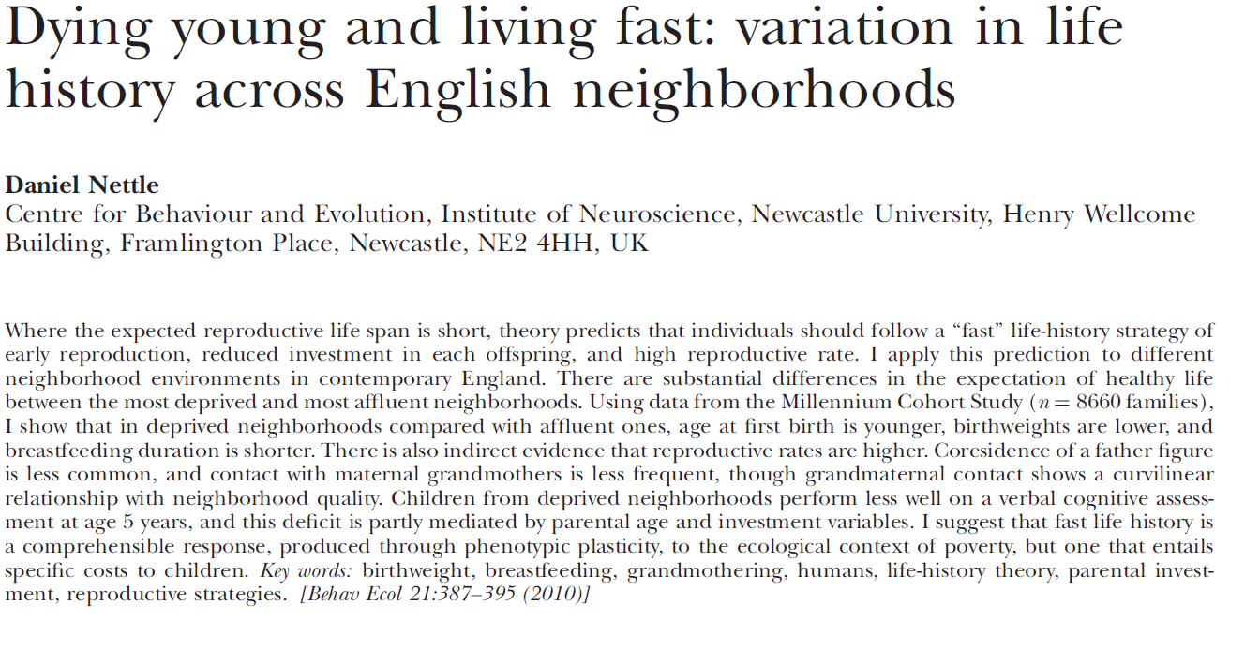

Slide 31
Acknowledgements
Liggins Institute &
AgResearch
Alan Beedle Tatjana Buklijas Felicia Low Mark Vickers
Graham Howie Alice Coveny Allan Sheppard Claudia Martinez
Paul Hofman Wayne Cutfield Deb Sloboda David Raubenheimer
Kate Franko Susan Morton Kevin Dudley Tony Pleasants
Sherie Ngo
Mark Hanson Graham Burdge Cyrus Cooper Karen Lillycrop
Emma Phillips Jo Slater-Jefferies Keith Godfrey Clive Osmond
Jo Rodford
Chong Yap Seng Emilia Tng Bright Emerald Neo Soek Ying
Michael Meaney Anne Ferguson-Smith Kenneth Kwek Seang Saw Mei
Hamish Spencer Peter Dearden
Pat Bateson
Southampton
Singapore
Otago
Cambridge

