Slide 1
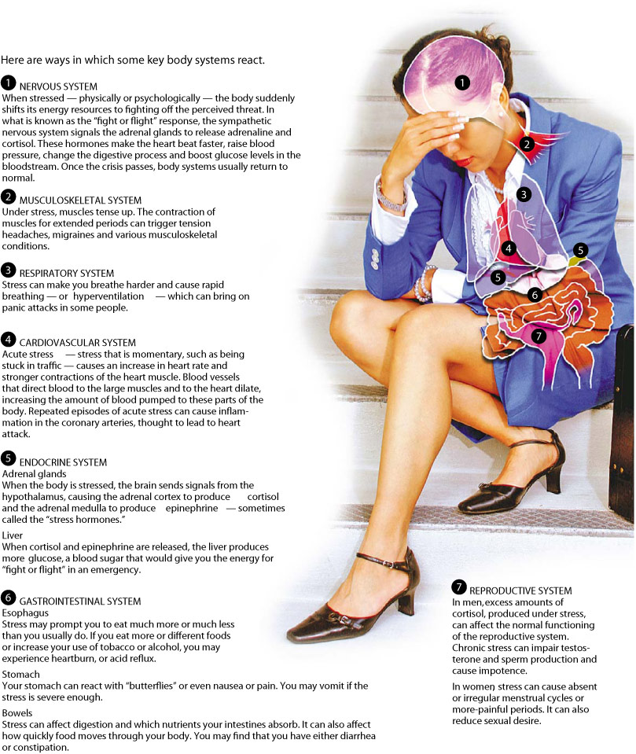
Stress and health
The epigenetics of human social stress response
Richard P. Ebstein, Ph.D.
Department of Psychology
National University of Singapore
& Hebrew University, Jerusalem

Slide 2
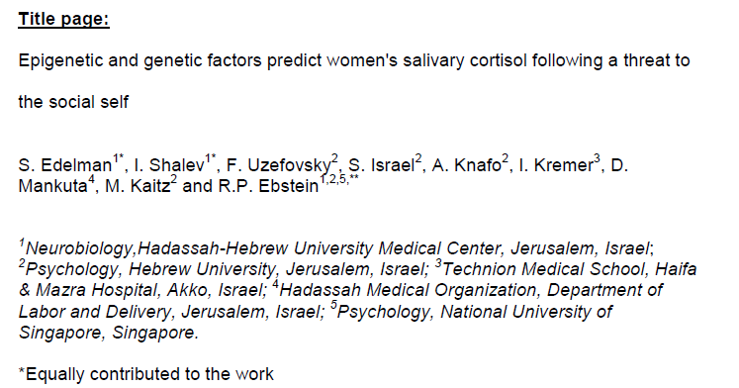
UNDER REVIEW

Slide 3
Psychosocial stress
Psychosocial stress along with the coping styles that people employ when challenged by stress, are considered important determinants of overall wellbeing (Miller, Chen & Cole 2009)
Particularly important is the body’s reaction to social stressors; reflecting the daily changes we face at home, with friends, during school and at work.
Dickerson & Kemeny (2004) review evidence that human cortisol responses to acute stressors are most pronounced in situations that pose a social threat to the individual “threat to the social self”.
Notably, not all individuals respond similarly to social stress and as noted by McEwen (2008) there are very large individual differences in stress reactivity, reflecting significant life events.
While some individuals appear to be resilient to difficult conditions, others react adversely to such challenges, incurring a range of physical and mental disorders.

Slide 4
Gender differences in reaction to social stress
One of the most consistent findings employing psychological stress tasks in the laboratory is the significantly larger salivary cortisol response in healthy adult men compared to women following short-term laboratory stress
Male stress responses may predominantly involve the traditional ‘‘fight and flight’’ reaction while women’s stress response may be better characterized by ‘‘tend and befriend’’, involving nurturant activities and the creation of social networks.

Slide 5
Why the difference in stress response?
Differences between genders in stress response can be attributed to circulating gonadal sex hormones, sexual dimporphism of brain functioning and corticosteroid binding to its receptor.
However, much of the underlying neurochemical and neurogenetic mechanisms for gender differences in stress reactivity generally remain obscure.

Slide 6
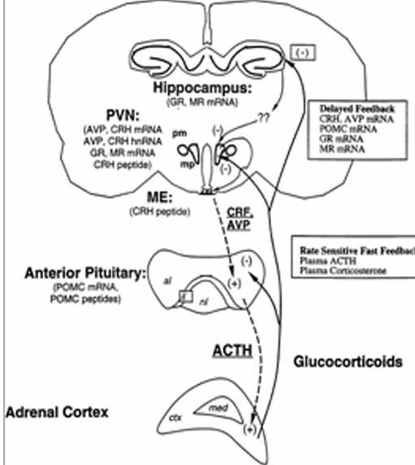



Slide 7
Glucocorticoid receptor
The final target of the HPAA cortisol release is the glucocorticoid receptor (GR, NR3C1).
The GR is a member of the steroid receptor superfamily and is the key mediator of the majority of cortisol’s tissue effects by way of direct binding to hormone-responsive elements in the DNA or via interactions with other transcription factors and regulation of gene transcription.
GR levels are transcriptionally controlled by multiple untranslated alternative first exons, each with its own promoter providing a mechanism for tissue-specific fine-tuning of GR levels

Slide 8
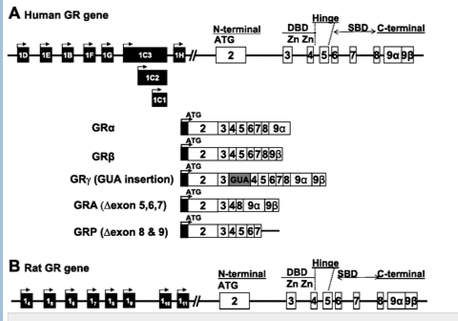
Notes:
Schematic diagram of glucocorticoid receptor (GR) gene in human (A) and rat (B). The human GR gene has 9 exons; 1 and 9 are subject to alternative splicing. As explained in the text, the human exon 1A (rat exon 1.1–1.3) is not shown, given its distance far upstream from the rest. Exon 9 can be spliced to join exon 8, generating GRα and GRβ isoforms. Other splicing variants are generated by the insertion of an additional codon (GUA) in DNA binding domain (DBD) between 2 zinc fingers (exons 3 and 4) to yield GRγ; by deletion of exons 5–7 [steroid binding domain (SBD)] to yield GRA; or by deletion of exons 8–9 (yields GRP).
Intrauterine growth retardation affects expression and epigenetic characteristics of the rat hippocampal glucocorticoid receptor gene

Slide 9
Genetics
Common polymorphisms in the GR and other genes partially contribute to disparities in HPAA reactivity
HPAA responsiveness to acute social stress is obtained by using a laboratory-based paradigm, the Trier Social Stress Test (TSST), that leverages a ‘threat to the social self’ via public speaking and mental arithmetic, to generate an unambiguous physiological endpoint, indexed by salivary cortisol.
Importantly, both the TSST response and basal cortisol levels have been shown to be substantially heritable , providing the necessary background for the current investigation.

Slide 10
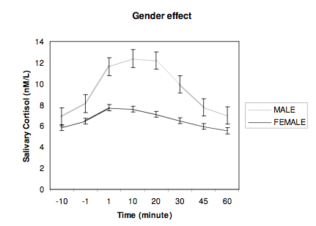
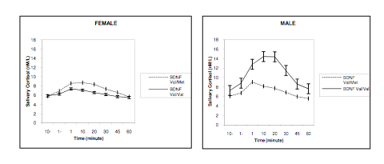
Shalev I, Lerer E, Israel S, Uzefovsky F, Gritsenko I, Mankuta D, et al. (2009): BDNF Val66Met polymorphism is associated with HPA axis reactivity to psychological stress characterized by genotype and gender interactions. Psychoneuroendocrinology. 34:382-388.
TRIER SOCIAL STRESS TEST “TSST’
1687-1674-1661-1648-1635……………
Notes:
Some of the individual differences we can explain by sequence variations in DNA e.g. BDNF polymorphism

Slide 11
The epigenome
There is increasing evidence for involvement of the epigenome in altering short and long-term status of GR and cortisol responsiveness.
The nerve growth factor-inducible protein A (NGFI-A), is a transcription factor that has been shown in the rat and human to regulate the expression of the NR3C1 promoter; its methylation down regulates gene expression .
In a seminal article, Weaver, Meaney and colleagues (2004) showed that differential maternal care in rat pups modified the methylation pattern of the hippocampal GR exon 1₇ which led to significant differences in subsequent adult behavior.
Importantly, the cytosine residue within the 5’ CpG dinucleotide of the noncononocal NGFI-A (CpG₃₁, CpG₃₂) consensus sequence was highly methylated (associated with low GR expression) in the offspring of low caring mothers, and rarely methylated (high GR expression) in the offspring of high caring dams explaining the observed differences in HPAA reactivity in the adult offspring.
The impact of maternal care on the epigenome is mediated by serotonergic (5-HT) neurotransmission that drives downstream expression of NGFI-A targeting its cognate binding site on the GR exon 1₇ promoter.

Slide 12
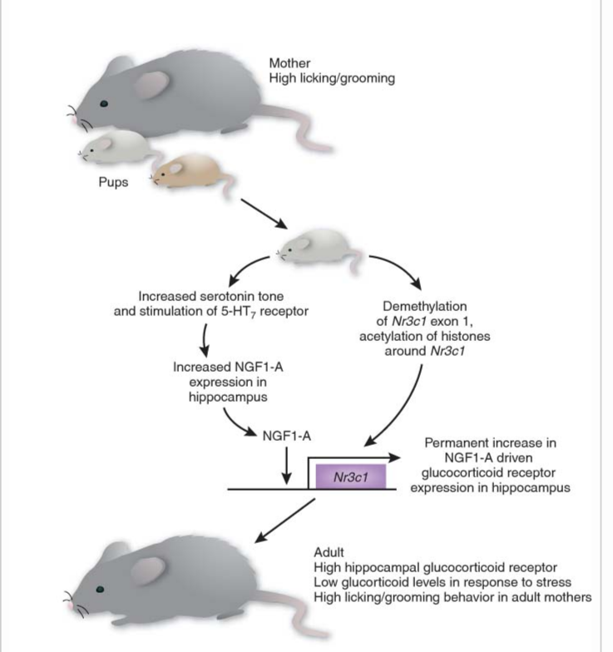
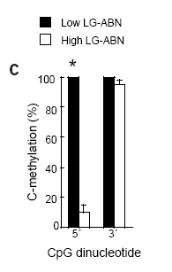
SITE 16=5’
SITE 17=3’

Slide 13
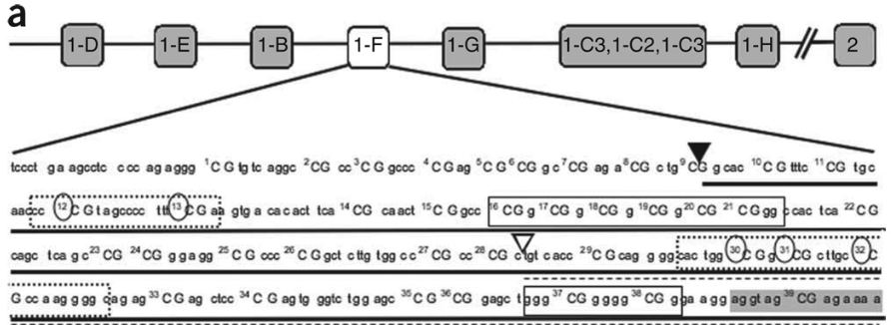
Human NGFI-A

Slide 14
Methylation of GR exon 1F in men and women
As previously reported by us (Shalev et al 2009) and others in both men and women there is a significant increase (greater in males compared to females) in salivary cortisol levels following the TSST (Figure 1)
The stress induced rise in salivary cortisol is presented in Figure 1 for each time point in a GLM repeated measures plot (SPSS) as well as AUC ( see insert) for both men and women.
There is a significant rise in cortisol (GLM repeated measures) for both men (tests of within subjects (F=22.32

Slide 15
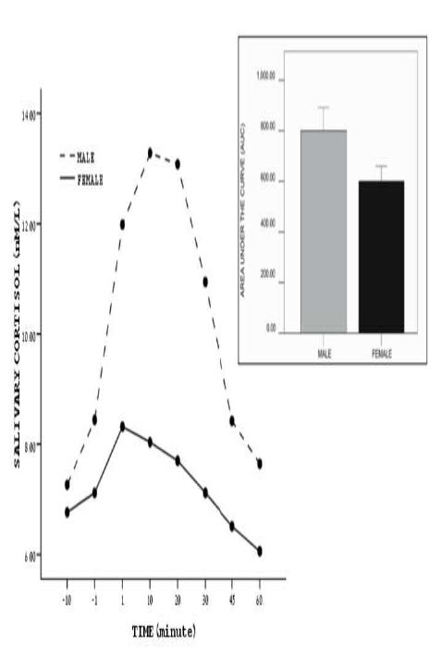
Edelman et al submitted

Slide 16
We next examined the methylation level and averaged the results across 39 assayed CpG sites in exon 1F for each subject (Figure 1).
Overall, women showed significantly greater methylation levels than did men (Figure 2A) across the entire promoter region (t=2.538, p=0.013).

Slide 17
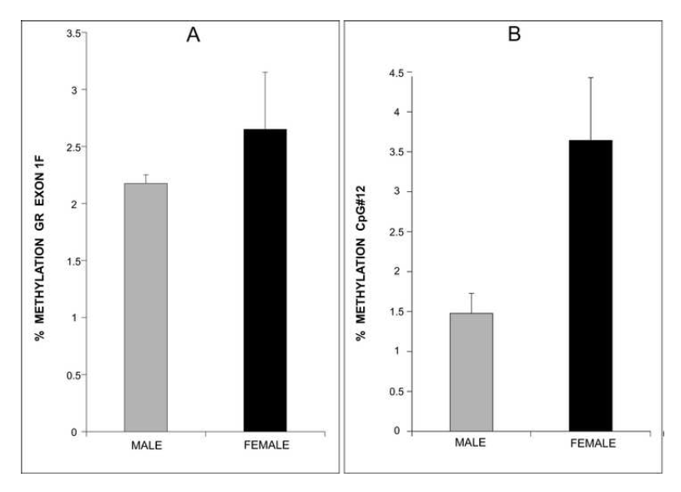

Slide 18
Notably, marked individual differences for both men and women were observed at many individual CpG sites (Figure 1A, 1B).
Overall levels of GR exon 1F methylation were similar to those previously observed by Oberlander et al ²³ in peripheral tissue.

Slide 19
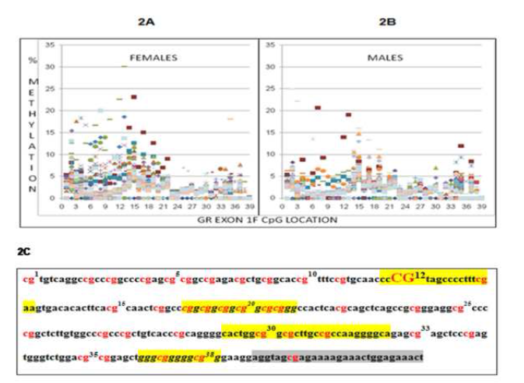

Slide 20
GR exon 1F methylation and total cortisol output (AUC)
We next examined the relationship between sex, average methylation level across exon 1F, the interaction (sex x methylation) and AUC (summarized in Table 1).
Sex (R²Δ=0.116 F_{1,89}=11.809, p=0.001) and 1F methylation (R²Δ=0.065 F_{1,88}=7.082 p=0.009) were significant predictors of AUC.
For men, methylation was not a significant predictor (p=0.722).
In contrast, for women (Figure 3), the average methylation level of the GR 1F exon was inversely related to the amount of salivary cortisol secreted (AUC) during the TSST (R²Δ=0.213 F_{1,44}=11.877, p=0.001), accounting for 21.3% of the variance.

Slide 21
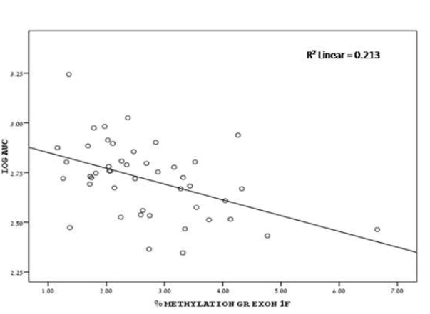

Slide 22
ESR1 and 5-HTTLPR are independent predictors of AUC
All subjects were genotyped for two relevant genes, the ESR1 and 5-HTTLPR.
In female subjects, there is a significant main effect of 5-HTTLPR (R²Δ=0.172, F_{1,42}=12.032, p=0.001 ) and ESR1 (R²Δ=0.132, F_{2,40}=5.634, p=0.007) on AUC.
Remarkably, in the full model (1F methylation, 5-HTTLPR and ESR1 polymorphisms) a total of 50.06% (adjusted R²) of the variance in total salivary cortisol output is explained. There was no significant effect of genotype on methylation.

Slide 23
Summing up…
A fuller understanding of the molecular mechanisms underlying differences between male and female response to stress has potentially profound implications for explaining gender differences in vulnerability to both psychopathology ⁴⁵ and physical disease ⁴⁶⁻⁴⁸.
We have used a well-characterized laboratory based social stress test to examine the impact of epigenetic and genetic variation on cortisol response in a group of nonclinical subjects.
In women, and not in men, the averaged methylation of 39 examined CpG sites located across the GR promoter exon 1F is a highly significant predictor of total cortisol response (AUC) in the TSST.
Importantly, women show significantly greater methylation in exon 1F, and at the NGFI-A transcription factor site, compared to men.

Slide 24
Indexing environmental challenges
We suggest the notion that DNA methylation patterns across the whole genome or at specific well-characterized candidate genes might prove to be an excellent proxy for indexing environmental challenges to the human organism from the prenatal period onward.
Indeed, combining sequence variations with individual differences in methylation patterns might turn out to be excellent predictors of salient biological, physiological and behavioral characteristics of individuals.

Slide 25


