Slide 1
Life course consequences of early life events?
L.H.Lumey
Department of Epidemiology
Columbia University, New York, NY
Biology, Genetics, and Econometrics of Health and Aging Conference. University of Chicago, September 16, 2011

Slide 2
Exploring pathways
Adult
Disease and Attainment
Adult
Metabolism
Epigenetic
Changes?
Adult
Morphology
Exposures in ‘critical’ periods

Slide 3
Human studies of poor nutrition during development
Nordic countries 19th century
Soviet Union 1930s
WWII 1939-1945
China 1959-1961
Seasonal famines 20th century

Slide 4
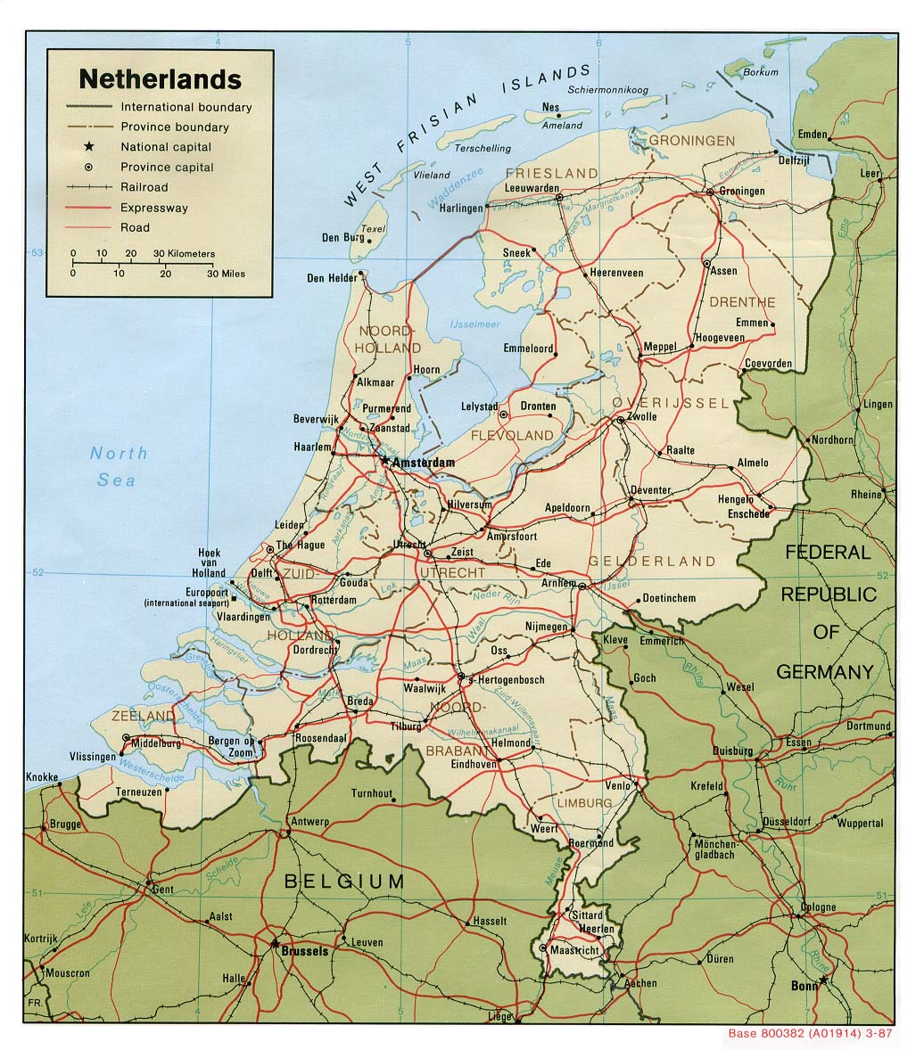
Dutch Hunger Winter
1944-45
Transport embargo
  German response to rail strike in support of advancing Allied troops.
  Rail strike was continued by Dutch for non-military reasons after failed military advance
Limited to western Netherlands
Ended with surrender of the German forces, May 1945

Slide 5
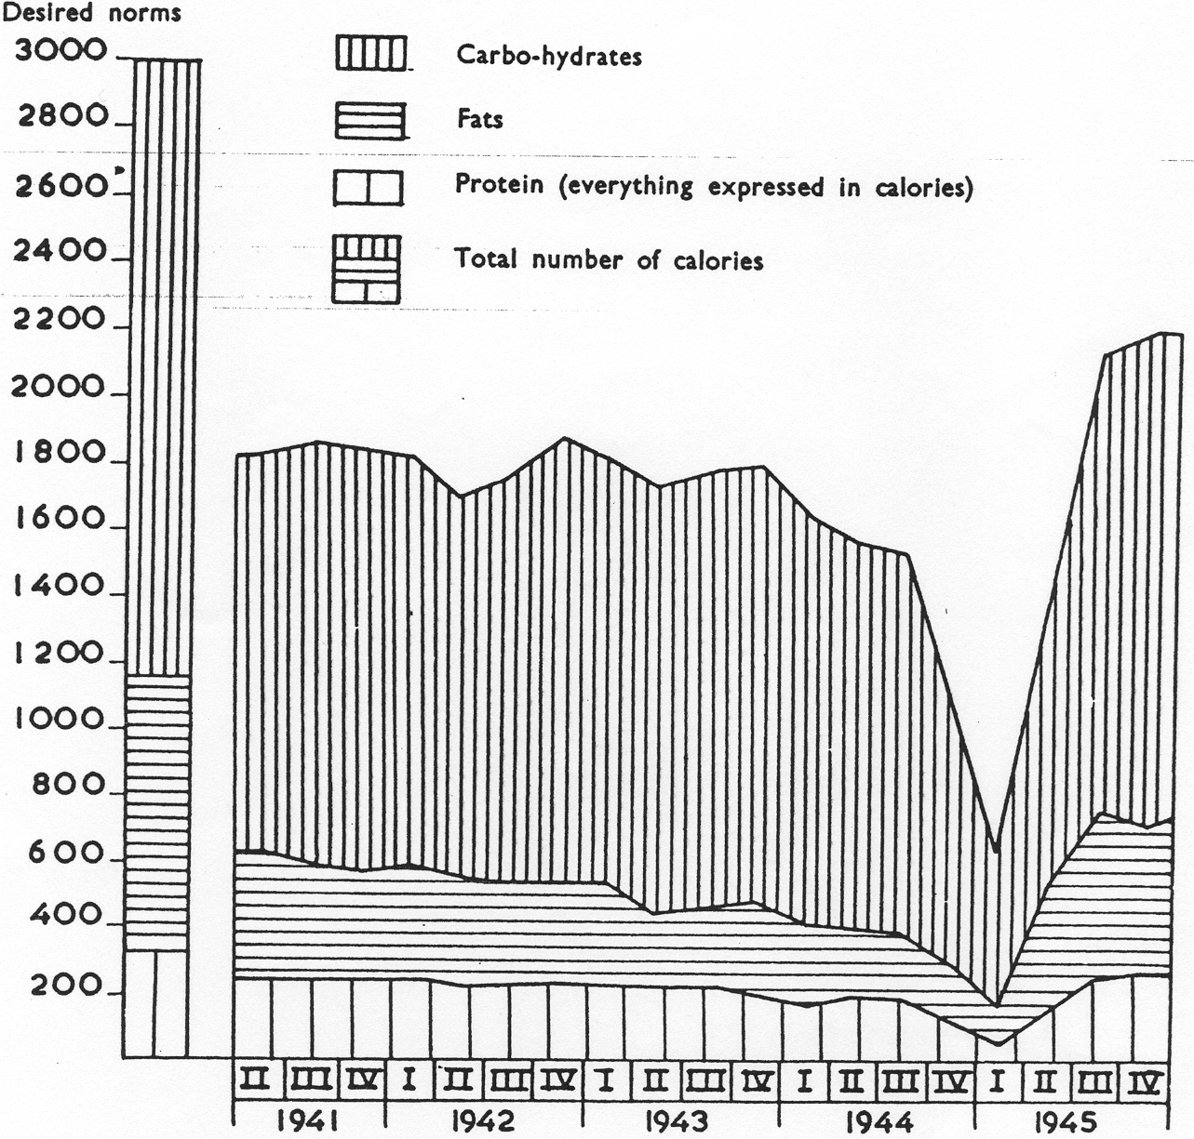
Food rations
Western Netherlands, 1941-1945
Burger et al, 1948

Slide 6
Fertility and social class
Dutch recruits by region of birth
1944-1947

Slide 7
Exposure categories
Rations<900kcal/day
Weeks 31- Delivery
Weeks 21-30
Weeks 11-20
Weeks 1- 10
1944
1945
1946

Slide 8
Hunger winter families study
Lumey et al., Int J Epid, 2007
3,307 births at three institutions:
  Amsterdam, Leiden, Rotterdam
  1943; Jan 45-Mar 46; 1947
Tracing through Population Registers
Recruitment via mail
Sibling controls
Telephone interviews 2003-2005 at age 59
Clinical assessments in Leiden at age 59
Funding: RO-1 HL067914

Slide 9
Size at birth
Dutch famine selected clinics
Stein et al., Int J Epi 2006

Slide 10
Outcome differences between siblings
(SD units)
Time controls
vs unexposed sibling
Famine exposed
vs unexposed sibling

Slide 11
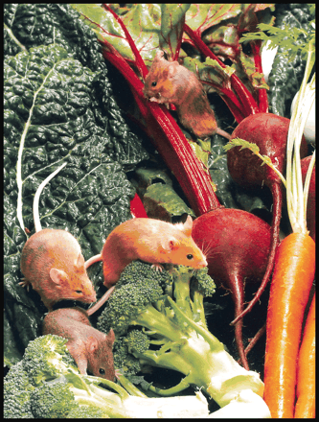
Pre-natal nutrition and methylation
Proof of concept in rodents
Agouti mice
Inbred: same DNA sequence
Methyl supplementation diet pregnant females
Recorded as higher methylation of agouti gene; no production of yellow coat
Retained into adulthood
Transmitted across generations, albeit diluted
Waterland and Jirtle. Mol Cell Biol 2003.

Slide 12
Pre-natal nutrition and methylation
Proof of concept in humans (IgF2)
Exposed-Unexposed
Methylation difference (%)
Daily ration
(kcal/day)
Estimated conception
(Last menstrual period)
Date of conception
Heijmans et al., PNAS, 2008

Slide 13
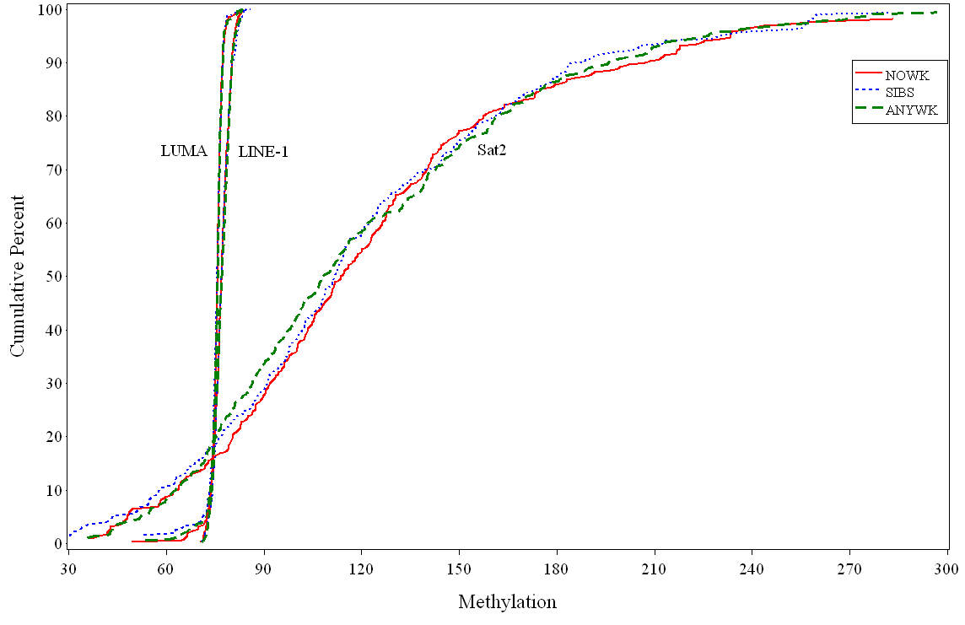
LUMA, LINE-2 and Sat2 global methylation by famine exposure status
Lumey et al., IJE (in press) Funding: RC1-1HD063549

Slide 14
LUMA, LINE-2 and Sat2 global methylation by famine exposure status
 | Overall % (s.d) | Famine % (95% CI) | p-value
Sat2 | 122.2% (56.2) | -0.51% (-7.38 to 6.36) | p=0.88
LUMA | 75.2% (4.7) | 0.16% (-0.49 to 0.81) | p=0.63
LINE-1 | 77.1% (2.5) | -0.05% (-0.33 to 0.22) | p=0.70

Slide 15
Mortality and cause of death in Dutch military
with FWA van Poppel, NIDI
Select 25,348 conscripts born in six cities in the West with prenatal famine exposure from 408,015 births 1944-1947
Link military ID with names
Match Vital status at Central Statistical Office (CBS)
Match and search missings by hand at Central Genealogy Office (CBG)
Find cause of death at CBS
Compare mortality with matched time and place controls
Compare other outcomes from administrative health services, social security databases, and income tax records
Funding: R01-AG028593

Slide 16
Dutch recruits born 1943-1947 follow-up 18-62 years, by month of birth
Month / Year of Birth | Alive at age 18 n | Alive at age 62 % | Dead at age 62 % | Not yet found, incl. emigration; %
Jan-Oct 1944 | 2,565 | 76.8 | 10.1 | 13.1
Nov 1944 | 1,628 | 78.8 | 12.2 | 9.0
Dec 1944 | 1,588 | 80.3 | 9.5 | 10.2
Jan 1945 | 1,718 | 79.3 | 10.1 | 10.7
Feb 1945 | 1,591 | 79.4 | 9.9 | 10.6
Mar 1945 | 1,675 | 76.7 | 11.8 | 1.6
Apr 1945 | 1,780 | 78.1 | 10.2 | 11.7
May 1945 | 1,704 | 78.9 | 10.3 | 10.8
Jun 1945 | 1,430 | 80.7 | 9.2 | 10.1
Jul 1945 | 1,444 | 81.0 | 9.6 | 9.4
Aug 1945 | 1,223 | 77.4 | 11.3 | 11.4
Sep 1945 | 999 | 77.5 | 11.9 | 10.6
Oct 1945 | 803 | 76.6 | 9.7 | 13.7
Nov 1945 | 744 | 78.1 | 9.9 | 12.0
Dec 1945 | 891 | 79.2 | 9.5 | 11.2
Jan 1946 | 1,181 | 80.5 | 9.6 | 9.9
Feb 1946 | 1,803 | 80.1 | 9.3 | 10.6
Mar 1946 | 3,081 | 80.3 | 9.9 | 9.8
Apr 46-Dec 47 | 7,431 | 80.9 | 9.8 | 9.3
Total West | 35,279 | 79.4 | 10.1 | 10.5
Total Non-famine | 9,758 | 79.4 | 9.3 | 11.3

Slide 17
Potential for future work
Explore linkages of CBS Microdata
Cause of death (ICD 10)
Hospital discharge diagnoses (ICD9-CM)
Long term care (admission to nursing home, psychiatric hospital, long-stay hospital, home for the handicapped, home care)
Prescription drug usage
Mental health care (outpatient and short term admissions)
Medical consumption (Hospital reimbursements; health insurance charges
Employment
Income (fiscal); social security benefits

Slide 18
Life course consequences of early life events?
Lumey et al., Ann Rev Publ Hlth, 2011
Schizophrenia
Body weight
Glucose metabolism and lipid profile?
Epigenetic profiles?

Slide 19

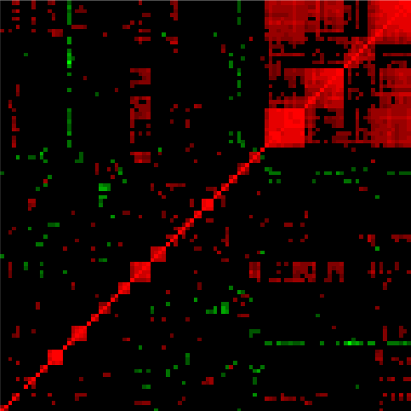
Recommendations
Combine studies
Integrate outcomes
Evaluate genome
Changes in offspring?
Need for explicit hypotheses
Replicate study findings

Slide 20

Acknowledgements
Molecular Epidemiology, LUMC,
Leiden, The Netherlands
Bas Heijmans
Elmar Tobi
Rudolf Talens
Dennis Kremer
Eline Slagboom
Collaborators USA
Aryeh D. Stein, Emory Univ, Atlanta, GA; Henry S. Kahn, Diabetes Division, CDC, Atlanta, GA; Patricia Zybert and Ezra Susser, Columbia University, New York, NY
TNO Netherlands
Margot van de Bor, Karin van der Pal, Frank Pierik
LUMC Netherlands
Gerard-Jan Blauw, Hans Romijn, Henriette Delemarre-vd Waal, Jos van Roosmalen
Advisors
George Davey Smith, Bristol, UK; Diana Kuh, London UK; Leiv Bakketeig, Oslo, Norway; Mervyn Susser and Zena Stein, NY USA.
Medical Statistics, LUMC Netherlands
Hein Putter
NIDI Demographic Institute, the Netherlands
F.W.A.van Poppel
P.Ekamper
Clinics and study subjects
Vroedvrouwenscholen Amsterdam en Rotterdam; Dept of Obstetrics, Leiden University, the Netherlands
All participating men and women
Funding
NHLBI, USA (RO1 HL-067914) and others
Notes:
20

Slide 21
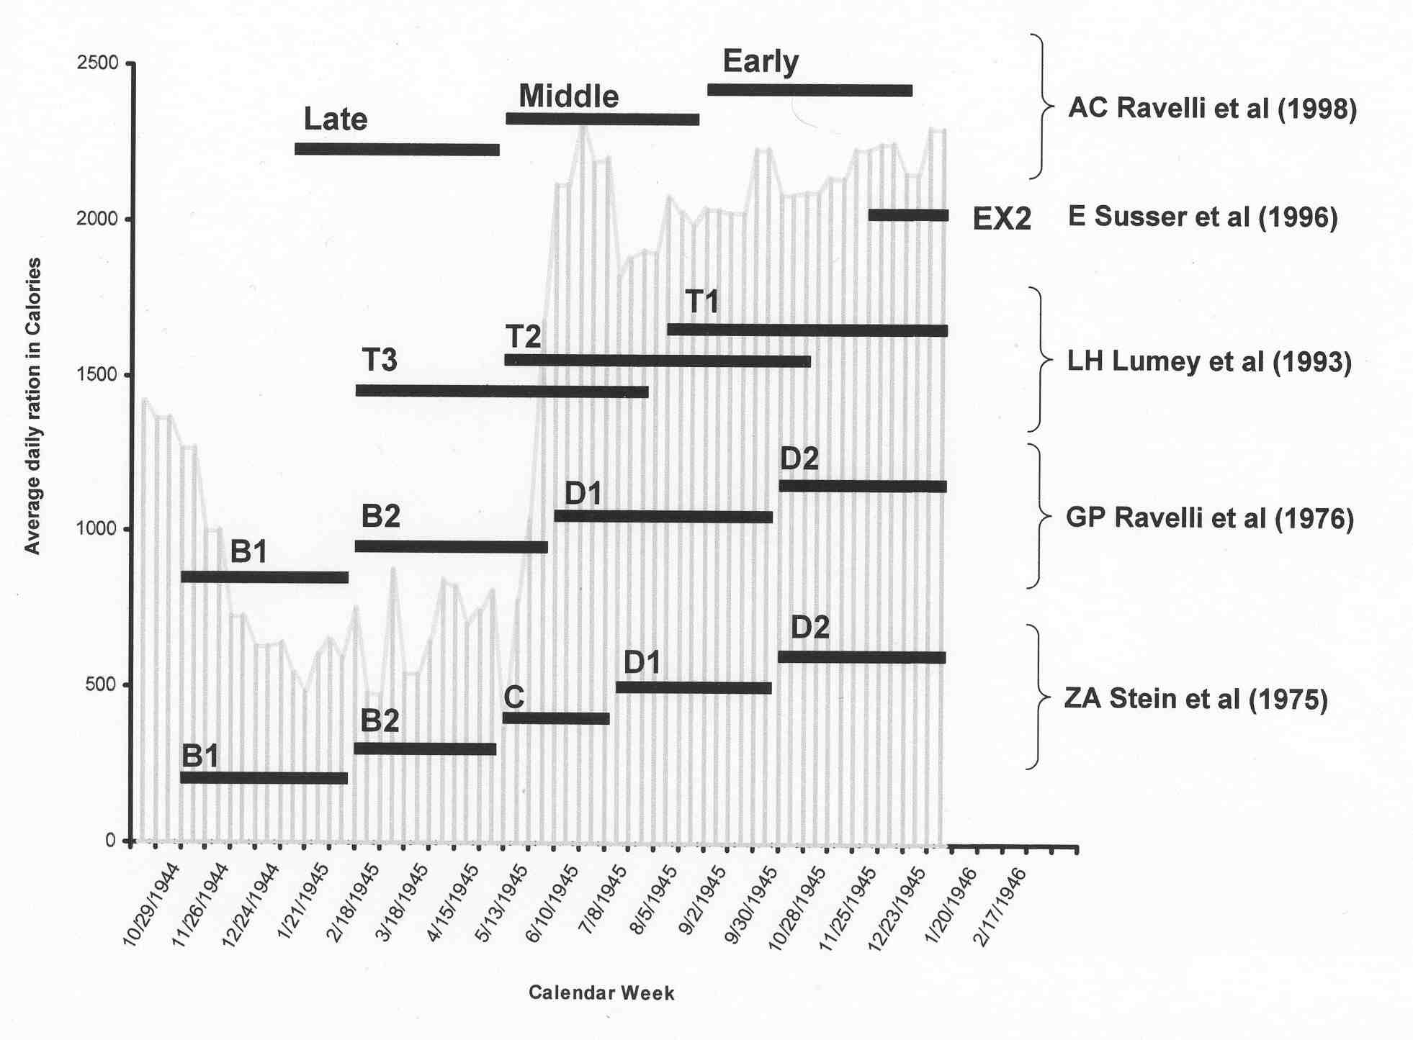
Dutch famine birth cohorts: exposure definitions by date of birth

