Slide 1
How Genes Shape Environments
Jenae M. Neiderhiser
Department of Psychology
The Pennsylvania State University
The Role of Genetic and Environmental Factors across the Lifecourse:
Improving the Rigor of Causal Inference. Chicago, September 2011

Slide 2
Questions for Session 4 – Psycho-Socio-Biological Linkages across the Lifespan
What is the contribution of genetic and environmental factors to health and ageing?
Do people make their own environments? Do they react to them? How robust is the evidence across research strategies?

Slide 3
This presentation…
Focus on gene-environment interplay
Genotype-environment correlation
Genotype x environment interaction
Use of twin, sibling and adoption designs
Examination of family relationships and impact on child, adolescent & adult adjustment

Slide 4
Acknowledging three teams of researchers in the US & Sweden
Twin and Offspring Study in Sweden (TOSS)
Cohort I: David Reiss, PI; Cohort II: JMN, PI – Supported by NIMH
Co-Investigators: Erica Spotts (NIA), Jody Ganiban (GWU), Nancy Pedersen & Paul Lichteinstein (KI), Marianne Cederblad & Kjell Hansson (Lund University)
Early Growth Development Study (EGDS)
Cohort I, Toddlers: David Reiss, PI; Cohort I, School: Leslie Leve, PI; Cohort II: Neiderhiser, PI; EGDS-Mental Health: Neiderhiser & Leve, PIs; EGDS-Health: Ganiban, PI – supported by NICHD, NIDA, NIMH, OBSSR & NIDDK
Co-Investigators: Daniel Shaw (Pitt), Xiaojia Ge (UMN), Laura Scaramella (UNO), John Reid (OSLC), Rand Conger (UCD), Misaki Natsuaki (UCR), Phil Fisher (OSLC)

Slide 5
Mechanisms of Parenting
G_{p}
G_{c}
Passive GE Correlation
Contextual
factors
Evocative GE Correlation
Parent’s
characteristics
Parenting
behavior
Child’s
characteristics

Slide 6
Mechanisms of Parenting
Psychopathology
G_{c}
Contextual
factors
Evocative GE Correlation
G_{p}
Social support
Parent’s
personality
Parenting
behavior
Child’s
characteristics
Partner relationships
Notes:
This is a rough approximation of a model proposed by Jay Belsky in the late 80s. In this model Jay proposed 3 primary influences on parenting behaviors, with contextual factors including things like SES, marital relationship quality, etc. The two most relevant to understanding rGE are parent’s characteristics and child’s characteristics. Specifically, if parents there are genetic influences on parent’s characteristics that then influence the way they parent, passive rGE is suggested, while if there are genetic influences on child’s characteristics that influence the way they are parented, evocative rGE is indicated. In the next set of analyses I will describe how we attempt to tease apart these different influences using a paired set of research studies focused on chidlren who vary in degree of genetic relatedness and parents who are twins.
6

Slide 7
Examining links between parenting & adolescent adjustment
Combine parent-based and child-based designs
Examine both samples within same model (rather than comparing)
Focus on adolescent adjustment

Slide 8
Children Of Twins Design (conceptual)
1.0 MZ; .5 DZ
Spouse 1 (Parent)
Twin 1 (Parent)
Twin 2 (Parent)
Spouse 2 (Parent)
.5 MZ parents; .25 DZ parents
.5
.5
.5
.5
Child 1
Child 2
.25 MZ parents; .125 DZ parents

Slide 9
Child Twin Design
Parent of twins
.5
.5
Child 1
Child 2
1.0 MZ twins; .50 DZ twins

Slide 10
Extended Children Of Twins Design (conceptual)
1.0 MZ; .5 DZ
Spouse 1 (Parent)
Twin 1 (Parent)
Twin 2 (Parent)
Spouse 2 (Parent)
.5 MZ parents; .25 DZ parents
.5
.5
.5
.5
Child 1
Child 2
.25 MZ parents; .125 DZ parents
AND
1.0 MZ twins; .50 DZ twins

Slide 11
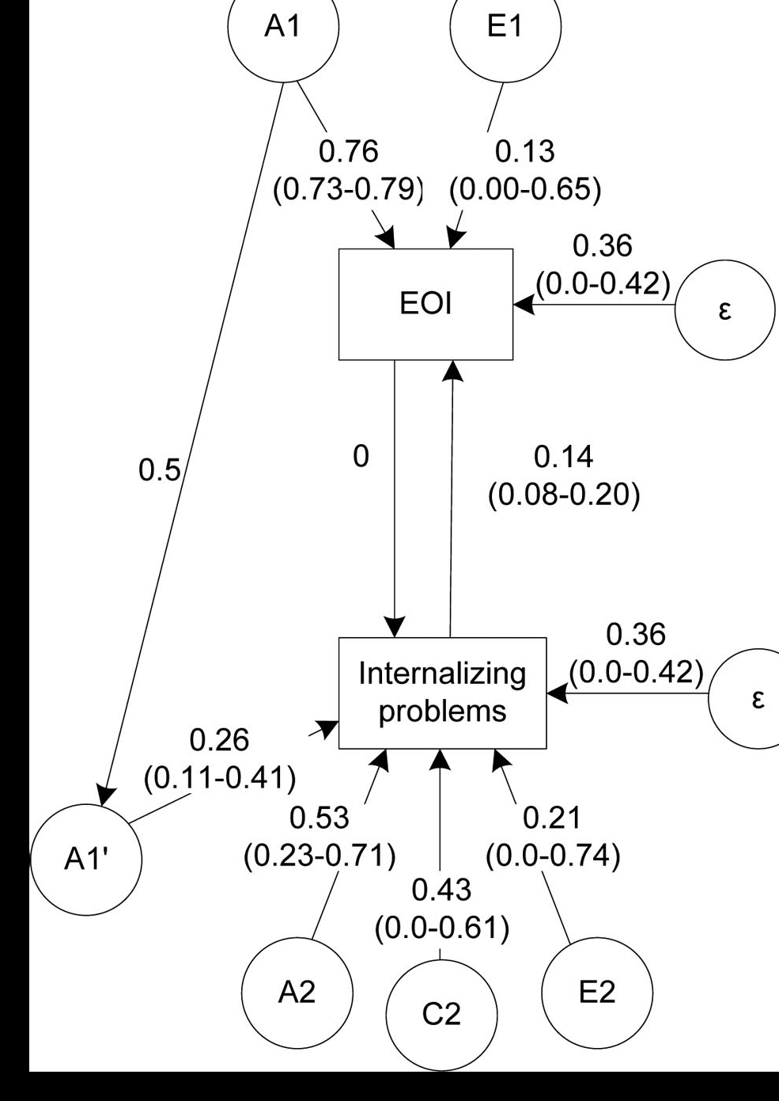
Findings from ECoT
Study 1 (Narusyte et al 2008):
Mother reports of maternal overinvolvement & adolescent internalizing problems
No passive rGE
No direct environmental effects
Significant EVOCATIVE rGE
Study 2 (Narusyte et al 2011):
Parental criticism and adolescent externalizing problems
Similar pattern of findings - evocative GE correlation for mothers
Direct environmental influences only for fathers

Slide 12
Interpretation
Children are eliciting parenting behaviors
Differential patterns of findings for mothers and fathers

Slide 13
Removing parents’ genes from the equation…
Findings from combined approaches underscore importance of parents genes
Only in an adoption design is parenting/rearing environment free of effects of correlations between parent and child genes

Slide 14
Clarifying G-E Interplay
Sensitivity to environment
Mechanisms of effects
Effects of parental depression

Slide 15
Birth mother psychopathology increases sensitivity of child to rearing environment
CBCL Total Problems T-score (18 Months)
1 or more SD below the mean on Birth M psychopathology, R² = .07
70
1 or more SD above the mean on Birth M psychopathology, R² = .31
65
60
55
50
45
40
35
30
0
20
40
60
80
100
120
Maternal Structured Guidance During Clean-Up Task
Leve et al., 2009

Slide 16
In other words – genetic factors influence the impact of the environment on development

Slide 17
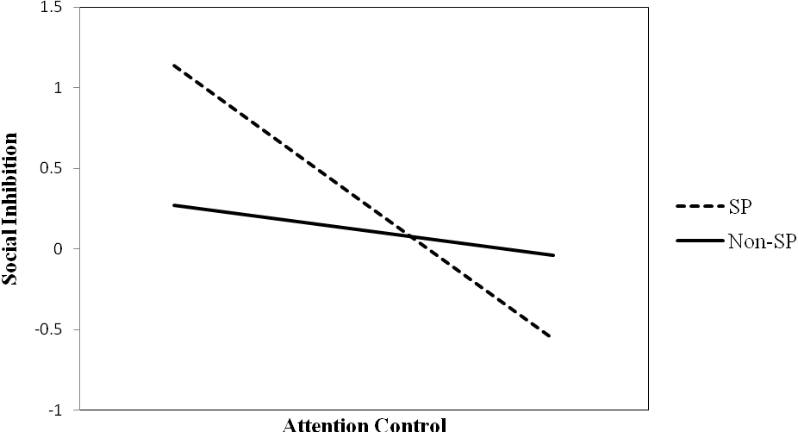
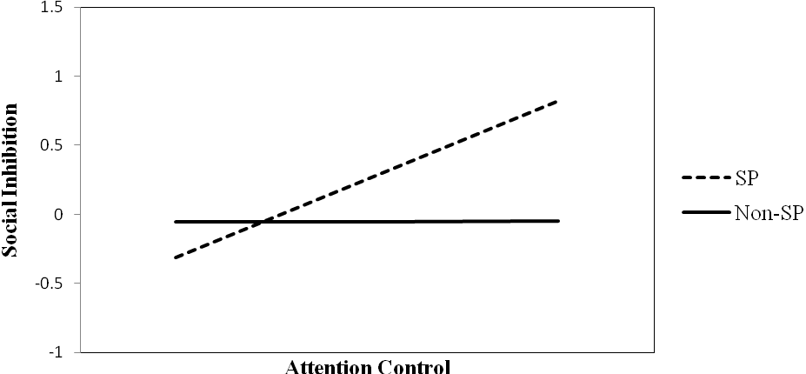
G x E x Child Behavior interaction
Low adoptive parent anxiety symptoms
β = -.87, t = -2.06, p<.05
β = -.87, t = -2.06, p<.05
β = -.16, t = -1.25, n.s.
SP: Social Phobic BP; Non-SP = Non Social Phobic BP
High adoptive parent anxiety symptoms
β = .57, t = 2.15, p<.05
β = .00, t = .04, n.s.
SP: Social Phobic BP; Non-SP = Non Social Phobic BP
Brooker et al., 2011

Slide 18
Interpretation
Genetic influences do not have a direct effect on infant’s early risk behaviors for anxiety (social inhibition)
Attentional control appears to be a mechanism through which genetic influences are moderated by environmental factors
Individual and modifiable characteristics are the route through which risk is translated to behavioral outcome

Slide 19
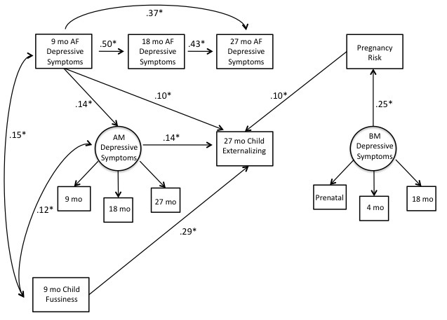
Influence of parent depression on toddler adjustment
From Pemberton (2010) Dev & Psychopathology

Slide 20
Summary
Impact of genetic and prenatal influences was masked before including environmental factors (adoptive parent depressive symptoms) in the model
Found no specific timing effects for adoptive mothers’ depressive symptoms
Early adoptive father depressive symptoms matter most
Directly influence later childhood problems
Indirectly operate through adoptive mothers

Slide 21
What does this mean?
Even traditional “environmental” influences may be confounded by genetic influences (rGE)
Genetic influences are not only risk or only protective
To a certain extent individuals do make their own environments via their genetically influenced characteristics
Findings do seem to replicate across multiple samples and studies and there is now more evidence at different points in the lifespan

