Slide 1

Epigenetic variation: a promising biomarker in health and disease?
Caroline Relton
Institute of Genetic Medicine
Newcastle University
UK

Slide 2
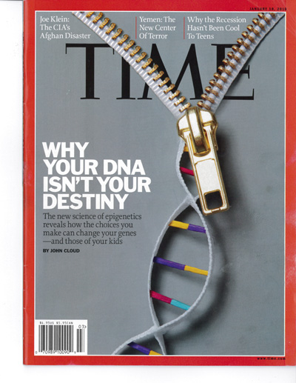

Slide 3
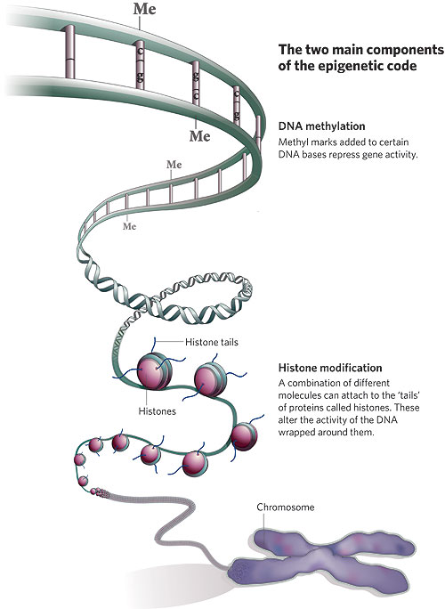
Epigenetics: a mechanism to explain how the genome ‘memorises’ environmental exposures
“Changes to the genome which are inherited from one generation to the next which alter gene expression but which do not alter the gene sequence”
DNA methylation
Histone modification
microRNAs
Somatic mitotic stability
Germ-line epigenetic inheritance
Trans-generational effects on phenotypic variation

Slide 4
Epigenetic patterns alter through the lifecourse
Germline
epimutation
Parental genomic
demethylation
Epigenetic drift / somatic epimutation
Developmental epigenetic programming
Waterland Nutr Rev 2008

Slide 5
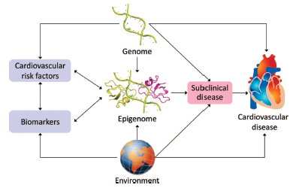
A conceptual model linking epigenetics to cardiovascular disease and cardiovascular risk factors
Baccarelli et al. Circulation 2010

Slide 6
The causal pathway
environment
methylation
expression
phenotype
SNP
methylation
expression
phenotype
Epigenetic patterns are phenotypic, there is nothing inherently different than studying any other socially or behaviourally patterned phenotype
Extravagant claims of the utlity of intermediate phenotypes have been made before – in the field of gene expression - that failed to replicate
Rigorous approaches are essential to ensure that meaningful inferences are made about causality

Slide 7
Epigenetic variation – fundamental issues
Can we identify epigenetically variable regions of the genome?
Can we measure variation accurately in individuals and populations?
How to we assess temporal stability?
  Developmentally determined changes
  Stochastic variation
  Environmentally-induced, exposure-related fluctuations
  Stable/persistent vs labile changes

Slide 8

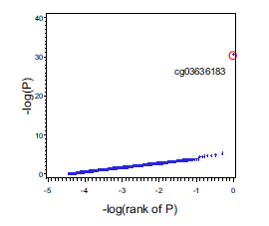

Does smoking impact upon DNA methylation?

Slide 9

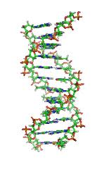
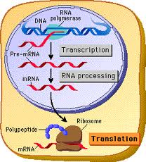
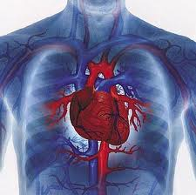
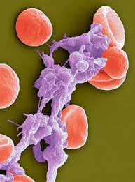
Epigenetic mediation of smoking and cardiovascular disease
Smoking associated with decreased methylation of the coagulation factor II receptor-like 3 gene (F2RL3)
Prompt increased expression of the protease-activated receptor-4 (PAR4)
Induces platelet activation (aggregation)
Plausible mechanism of smoking induced myocardial pathology
↑ smoking
↓ methylation
F2RL3
↑ expression
PAR4
↑ platelet
aggregation
↑ risk CVD

Slide 10
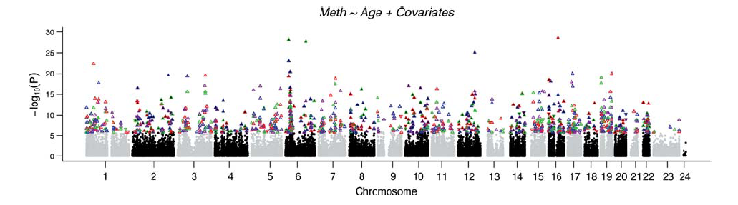
Age-related change in methylation
Manhattan plot showing association between methylation at individual CpG sites and chronological age. Plotted are P-values indicating strength of association between DNA methylation levels at >27 000 CpG sites and age in cerebellum (purple), frontal cortex (green), pons (blue) and temporal cortex (red). For each point, a positive association between DNA methylation and chronological age is indicated by upward pointing triangles; a negative association is indicated by downward pointing triangles.
Hernandez et al. Hum Mol Genet 2011

Slide 11
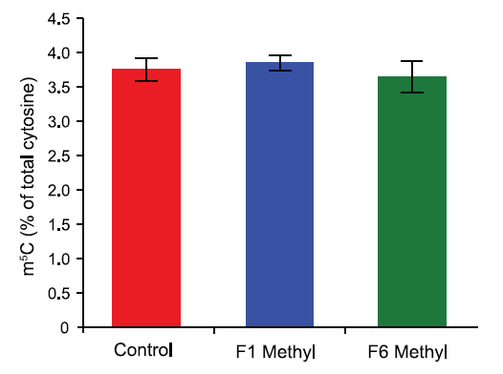
Dietary influences on epigenetic variance in isogenic mice
Methylation levels are unchanged after methyl donor supplementation
Whole-genome 5-methylcytosine (m⁵C) content in liver DNA from control, F1 supplemented and F6 supplemented mice
Li et al PLoS Genetics 2011

Slide 12
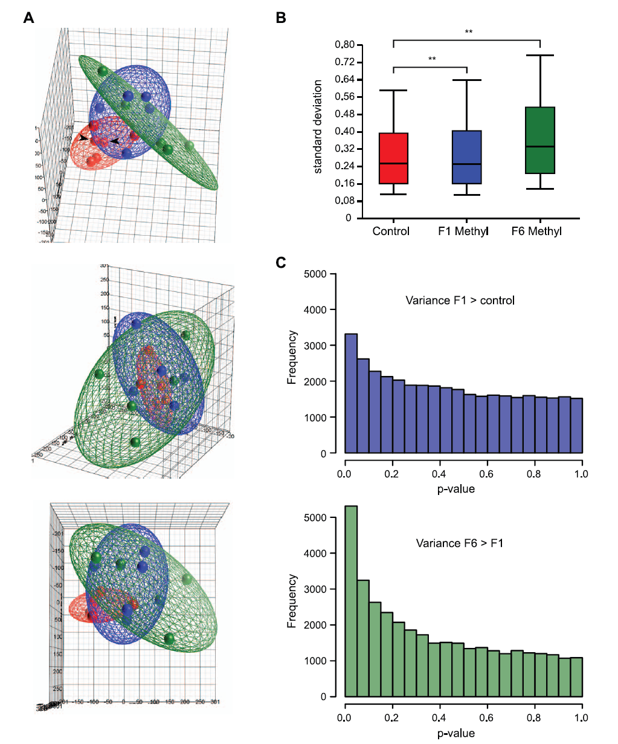
Methyl donor supplementation increases epigenetic variation in exposed mice
Pseudo three-dimensional plot showing PCA of microarray data from control and F1 and F6 supplemented mice. The ellipsoids around the PCA scores of each group were determined by standard deviations, so that their size is indicative of the overall variance within the group.
Li et al PLoS Genetics 2011

Slide 13
‘Genetical epigenomics’: Extending the principles of Mendelian randomization
ADH1B
Alcohol
Cancer
Confounders
ADH1B
cis-SNP
Alcohol
methQTL
Cancer
Alcohol
methQTL
Cancer
Confounders
Confounders
Relton & Davey Smith PLoS Med 2010

Slide 14
Using cis SNPs to strengthen causal inference in a study of postnatal growth and childhood adiposity
CpG sites
Transcription factor binding modules
-437
-430
-428
-439
-455
-453
-467
NFKB_CREB_01
-658
IRFF_ETSF_02
-587
-614
-683
Chr1:58815817-58816116
-625
-629
rs61779296
rs61779296
TACSTD2
SNP
TACSTD2
methQTL
Postnatal growth
Childhood adiposity
Confounders

Slide 15

Applications in behaviour-related contexts
Maternal / in utero effects of behavioural and lifestyle influences on offspring epigenetic patterns
Adolescent alcohol consumption habits
Eating disorders
PTSD
Conduct problems
Early childhood adversity

